Slide 1
Building Offline Ready Mobile Apps
Hristo Borisov
Product Manager
Telerik Platform
Notes:
I will be introducing myself for about 3 minutes. Tell them about my background and experience at Telerik.

Slide 2
You cannot build successful large scale mobile apps without robust offline capabilities.
Notes:
I will tell them that there will be one important thing that they should get away from this talk, and it’s that “You cannot build successful mobile apps without robust offline capabilities”. It’s inevitable that your customers will get to the point to ask you to support offline scenarios.

Slide 3

It’s all about
user experience
Notes:
Offline is giving you the ability to really improve the user experience like no other way. You are making sure that your app is fast, responsive, and pleasure to use. It’s the cherry on top of the cake for a well build mobile application.

Slide 4
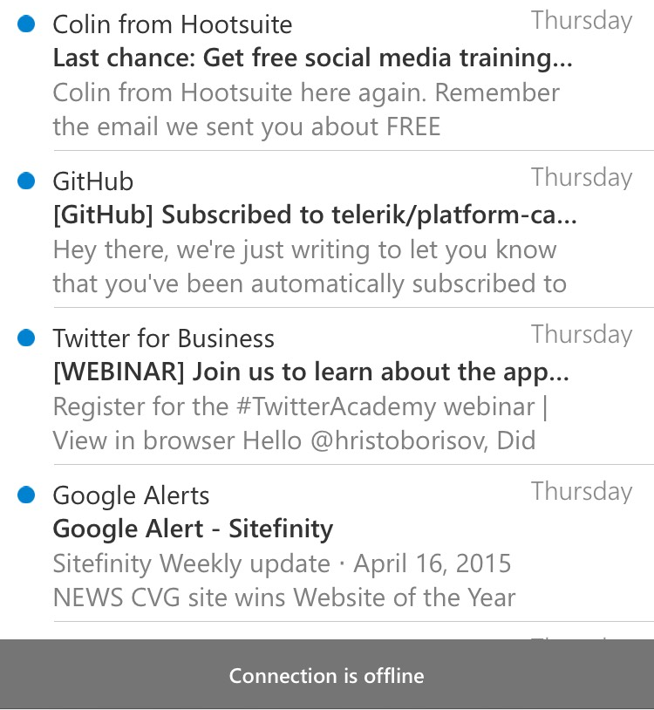
Your app is always responsive even without internet connection.
Notes:
You don’t have to send strange error message, and let the user know that he doesn’t have internet connection. The chance is - he ALREADY knows it! Responsive doesn’t mean good exception handling.

Slide 5
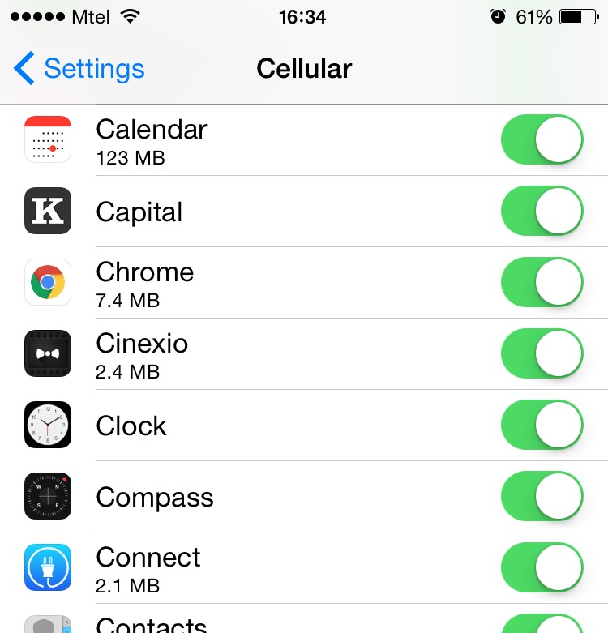
Your app is light and fast.
Notes:
The performance of your app could improve significantly as there are many factors to consider. You will get significant performance from the low number of roundtrips to your server. This will also decrease the bandwidth consumption of the mobile clients which is always a factor to consider for users especially if you are building a B2C app.

Slide 6

Before we jump - what is offline?
Notes:
Before we jump into discussing offline capabilities, it will be best to cover some of the benefits and use cases you get from building this technology, and also understand some of the pitfalls you need to know.

Slide 7
Building blocks of Offline
Offline data storage
Synchronization
Conflict Resolution
Caching
Notes:
When you talk about Offline in a mobile app, there are several important aspects to it.
Offline data store - first of all, you need a mechanism to persist the data at the device, and ensure that you can actually easily manipulate the objects in it.
Synchronization - when there is connectivity, you should be able to easily synchronize the client information with the server, so that your app information is up to date.
Conflict Resolution - in the process of synchronization, you need to ensure that any conflicts that might occur between the data stored at the server and the client is resolved. There are many strategy for this including server side resolution and client side. Today, we will be covering client side resolution.
Caching - Even though you might want to enable offline for all of your data, it might be not that efficient. You can decide to persist just a single entity at the client that you know doesn’t have to be refreshed often such as list of Cities, Countries etc.

Slide 8
Offline data storage
Native apps - Allocated space in the file system.
Web apps - Local storage of the browser.
Hybrid apps - you can use either the local storage of the browser or the file system using a plug-in.
Notes:
First of all, you need a mechanism to persist the data at the device, and ensure that you can actually easily manipulate the objects in it.
Native - For native apps we could interact directly with the file system of the device and store our objects. We can also store the information in a SQL Light or any other format we find appropriate.
Web - You can use the local storage of the browser to persist changes between sessions. Note that it’s limited to 5 MBs in size.
Hybrid - For hybrid apps, you have two options in general. You can either persist your data in the local storage of the browser, or you can use the file system plug-in.

Slide 9
Synchronization
You can synchronize the data between the client and the server at any given point.
Notes:
Synchronization - when there is connectivity, you should be able to easily synchronize the client information with the server, so that your app information is up to date. You can also perform synchronization at any given time depending on your requirements.

Slide 10
Conflict Resolution [at the client]
Multiple strategies:
Client Wins
Server Wins
Custom
Notes:
Conflict Resolution - in the process of synchronization, you need to ensure that any conflicts that might occur between the data stored at the server and the client is resolved. There are many strategy for this including server side resolution and client side. Today, we will be covering client side resolution.
Client wins - pretty much ignore the changes that have occurred on the server, and take the client side object as the newest one.
Server wins - if somebody has made changes before you on the server, ignore the client side changes.
Custom - based on your requirements you can create your own custom function that receives the server and the client item and you determine by yourself what to persist.

Slide 11
Caching
Ability to cache at the client specific objects with expiration date.
Notes:
Caching - Even though you might want to enable offline for all of your data, it might be not that efficient. You can decide to persist just a single entity at the client that you know doesn’t have to be refreshed often such as list of Cities, Countries etc. You can also set an expiration date to most of these entities, so that the object can expire.

Slide 12
Things to consider when choosing a solution for offline
Robust storage mechanism
Encryption
Plays nicely with your server
Can be easily integrated in your client
Make sure all components are ready for offline
Notes:
Robust mechanism - Ensure that you solution has robust mechanism for storing and persisting the data. Local storage is good, but contains a lot of limitations.
Plays nicely with your server - You can easily integrate your technology using the services that you have.
Can easily be integrated in your client - that you can naturally and easily benefit from offline capabilities without starting everything from scratch. It’s often that offline capabilities might be coming later in the product stage.
All components are ready - Make sure that all other frameworks and components are ready to be used in offline mode. For example in Telerik, the Telerik Analytics is allowing you to persist your data internally and synchronizes these changes with the server when there is connectivity.

Slide 13
Offline in Telerik Platform
Notes:
Let’s use the Telerik Platform to learn more about offline capabilities.

Slide 14
Introducing Offline in Telerik Backend Services
Notes:
Offline is giving you the ability to really improve the user experience like no other way. You are making sure that your app is fast, responsive, and pleasure to use. It’s the cherry on top of the cake for a well build mobile application.

Slide 15
Offline support for Telerik Backend Services
Support for Hybrid and Web apps
Support for Native apps via NativeScript
Synchronization mechanism with conflict resolution
Seamless integration with existing database systems:
MS SQL Server
Oracle
MySQL
Postgre SQL
Notes:
Built-in support in the JS SDK for Hybrid -
Built-in support in the JS SDK for NativeScript
Robust synchronization mechanism with conflict resolution
Can use both the browser and the file system
Seamless integration with existing database systems such as MS SQL Server, Oracle, MySQL and Postgre SQL

Slide 16
Demo
Notes:
Let’s use the Telerik Platform to learn more about offline capabilities.

Slide 17
Q&A
Survey feedback: http://bit.ly/next-borisov
Notes:
Let’s use the Telerik Platform to learn more about offline capabilities.

